Slide 1

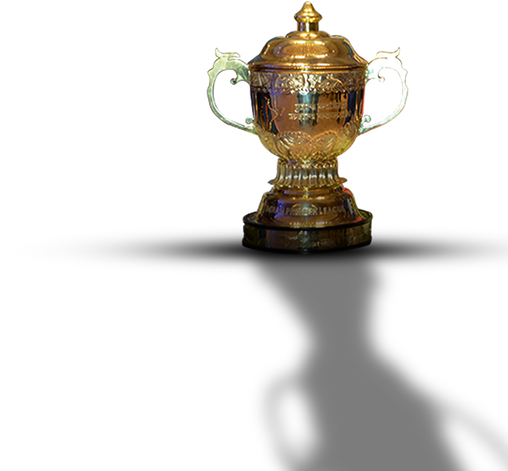
DREAM 11 WORLD CUP TEAM
GROUP 6
ARJUN P
ASHWIN NARAYANAN S
A SANDILYA SREEPADH
ANANYA R
DEEPAK KONA

Slide 2


PREDICTING RUNS

Slide 3


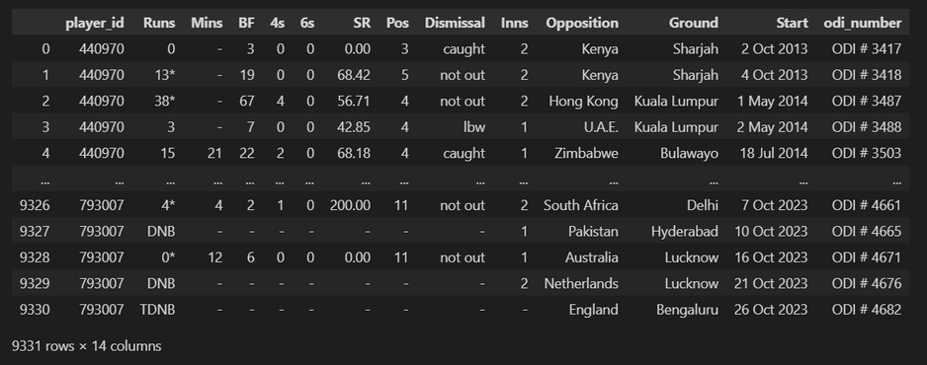
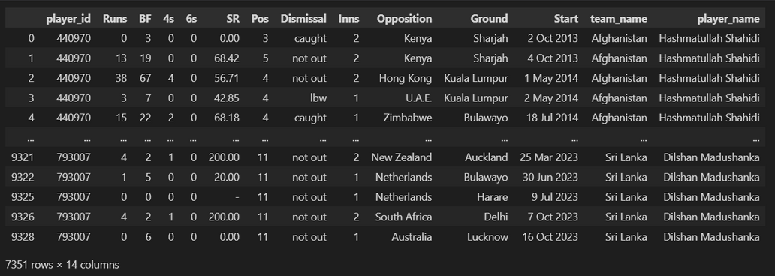
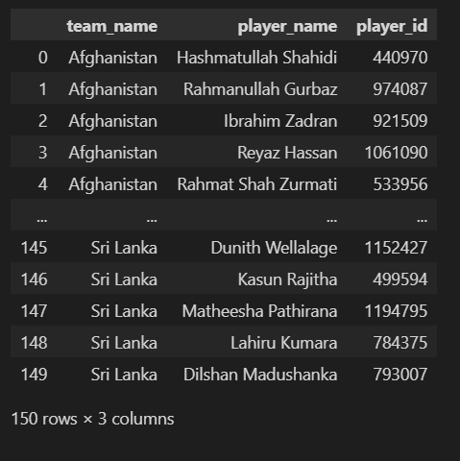
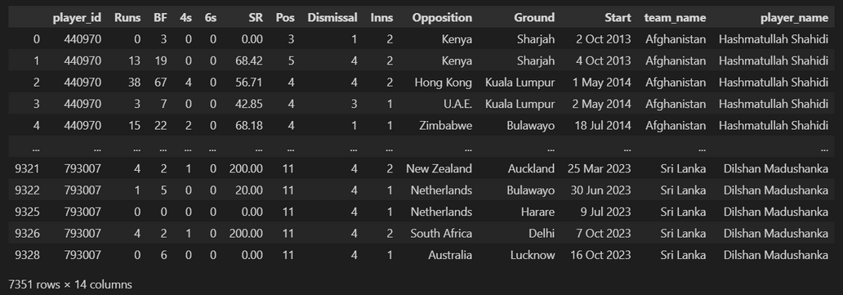
DATASET
PREPROCESSED DATA
LABEL ENCODING

Slide 4


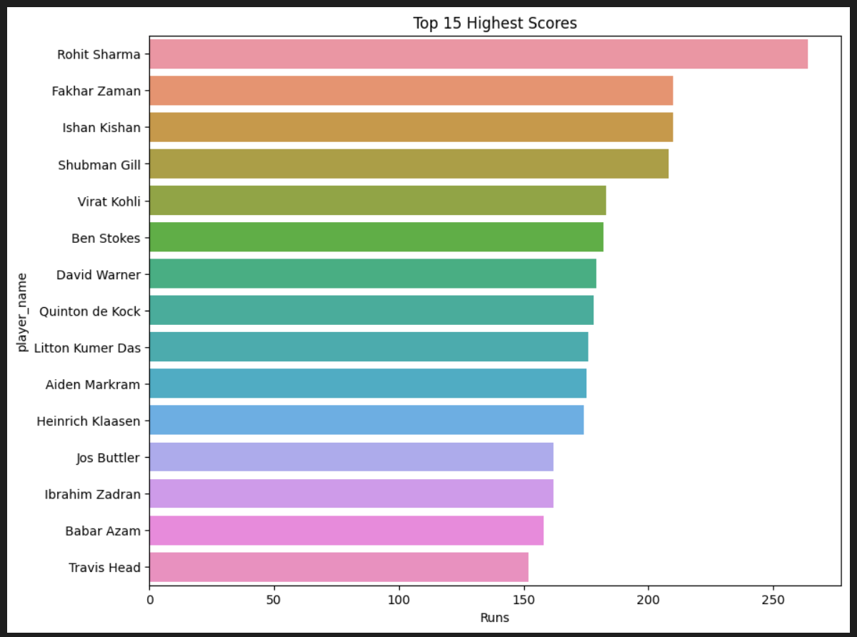

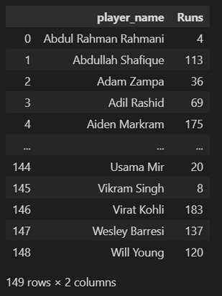

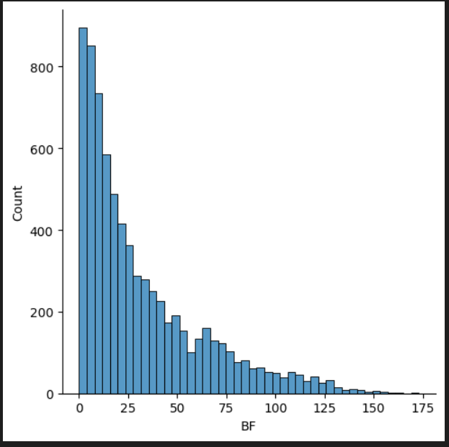
VISUALIZATION

Slide 5


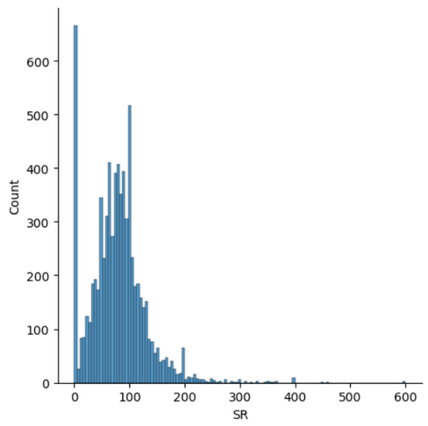
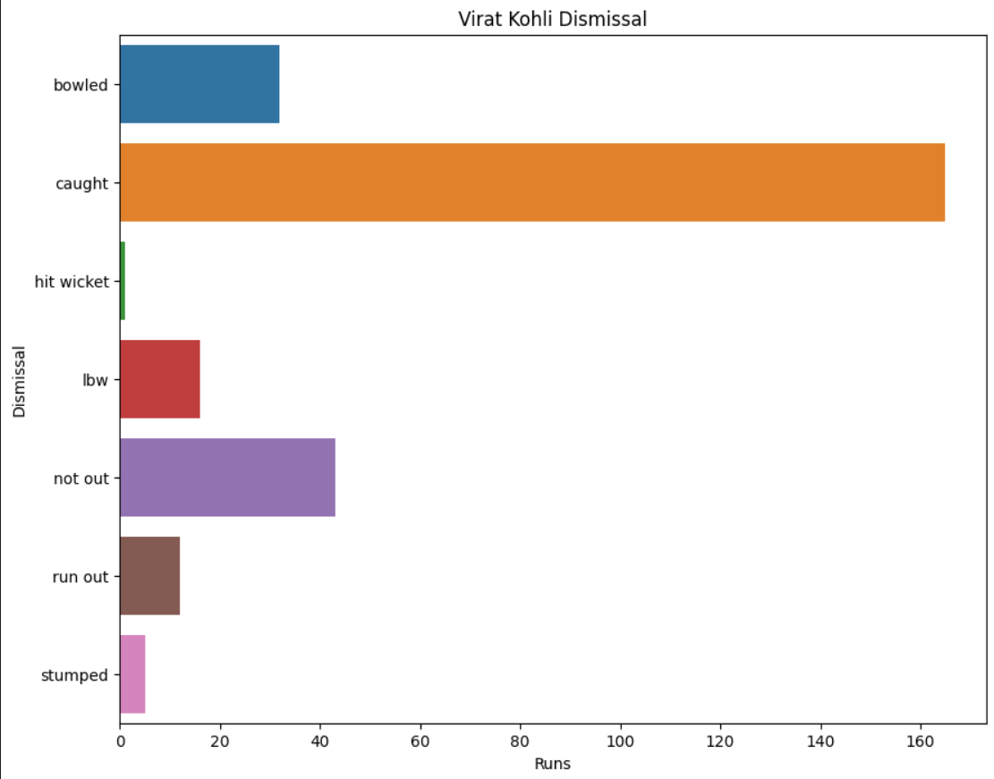

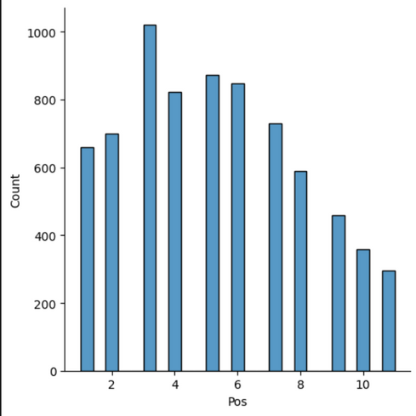
VISUALIZATION

Slide 6

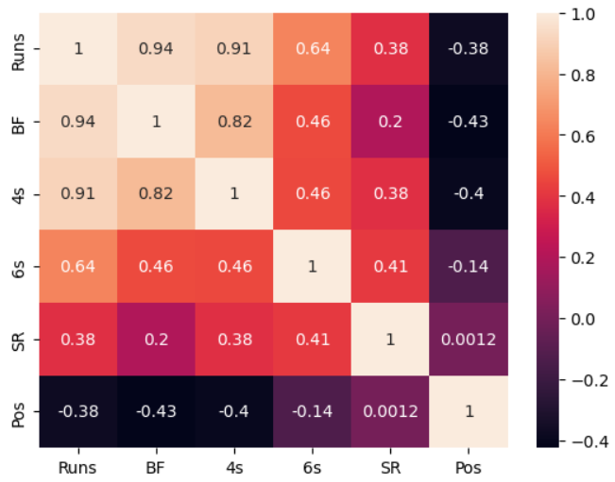
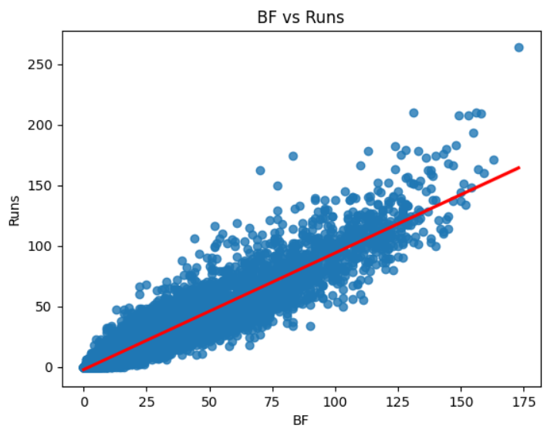
VISUALIZATION
HEATMAP
Runs and Balls Faced are highly correlated.
So, it has a greater impact on the model. Let's plot and see.

Slide 7
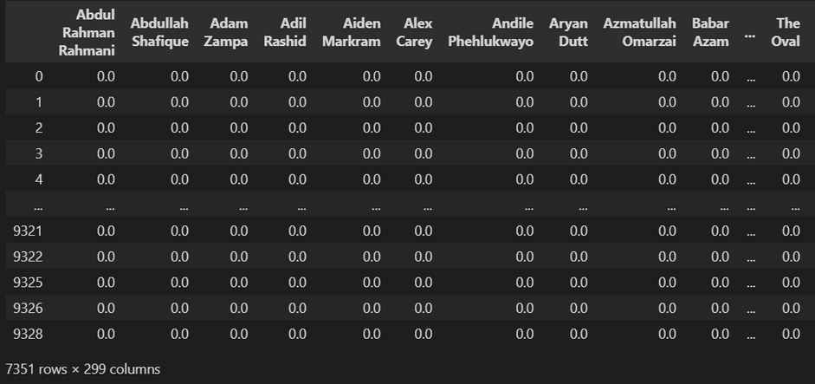

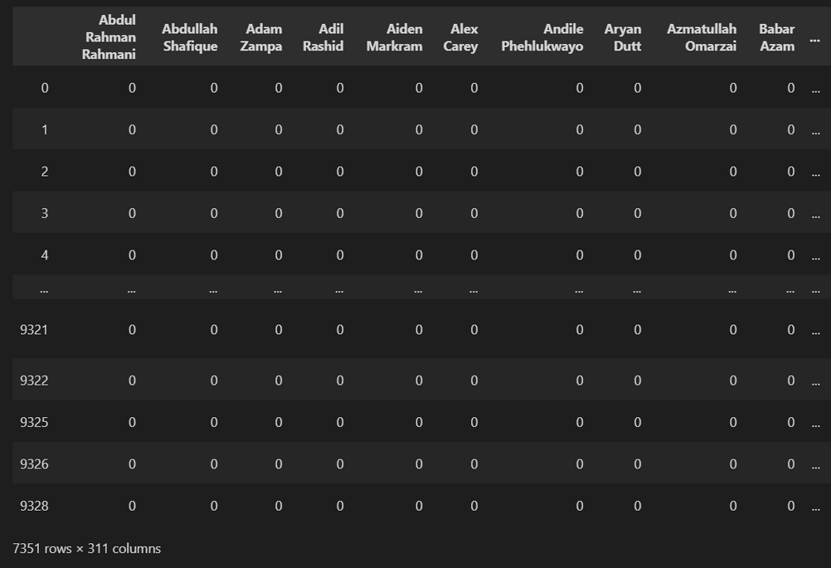

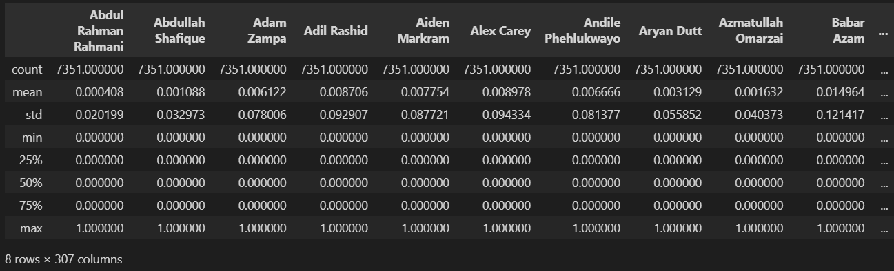
VISUALIZATION
Encoding team names with dummies. One hot encoding

Slide 8

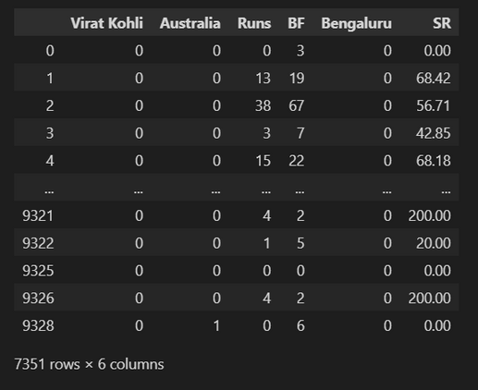
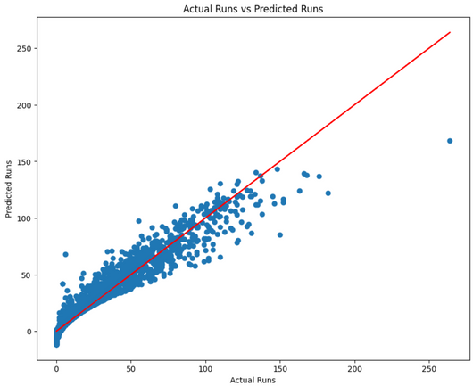

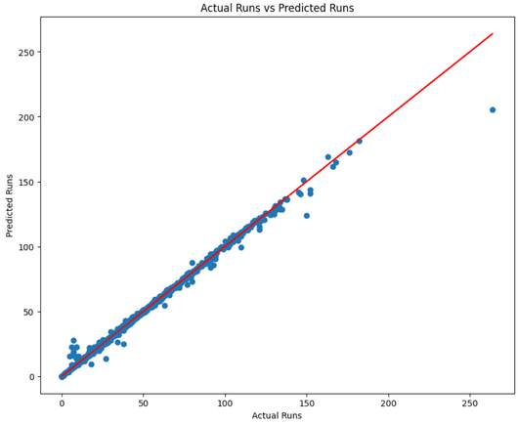
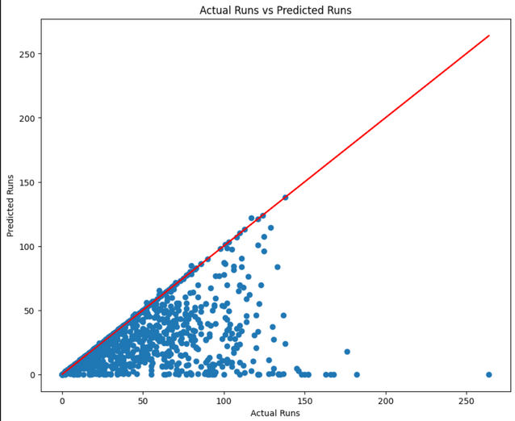
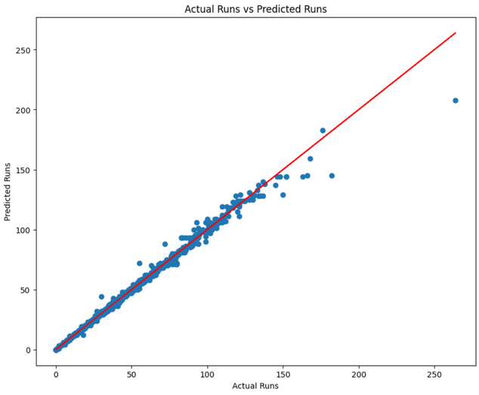
MODEL BUILDING
LINEAR REGRESSION
BAYESIAN REGRESSION
KNN REGRESSION
GAUSSIAN PROCESS REGRESSION
DECISION TREE REGRESSION

Slide 9
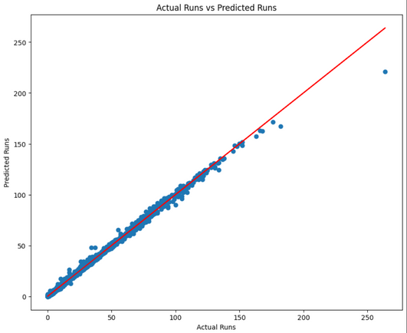
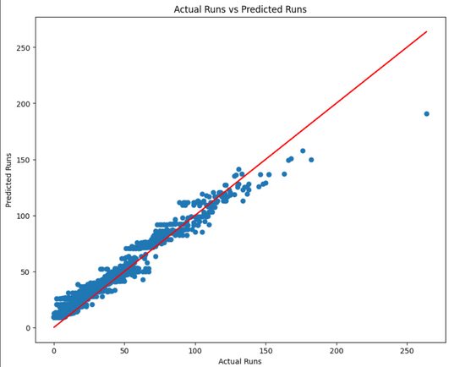
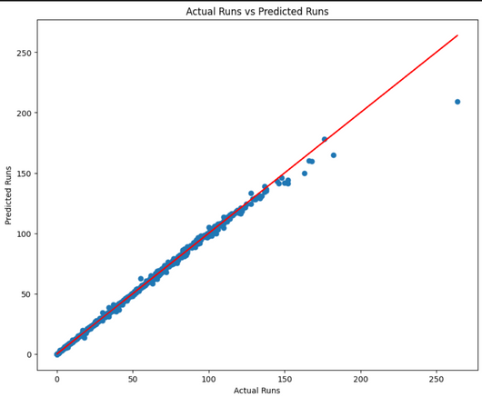
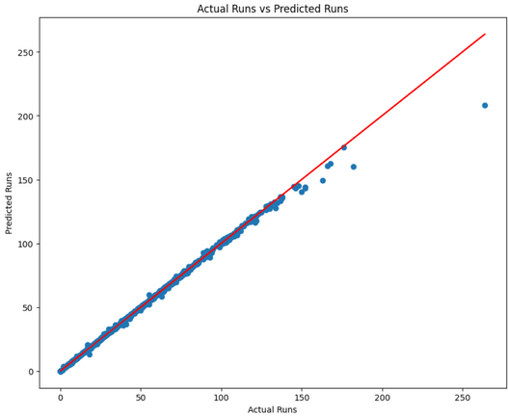
ENSEMBLE METHODS
GRADIENT BOOSTING REGRESSION
ADA BOOST REGRESSION
BAGGING REGRESSION
RANDOM FOREST REGRESSION

Slide 10
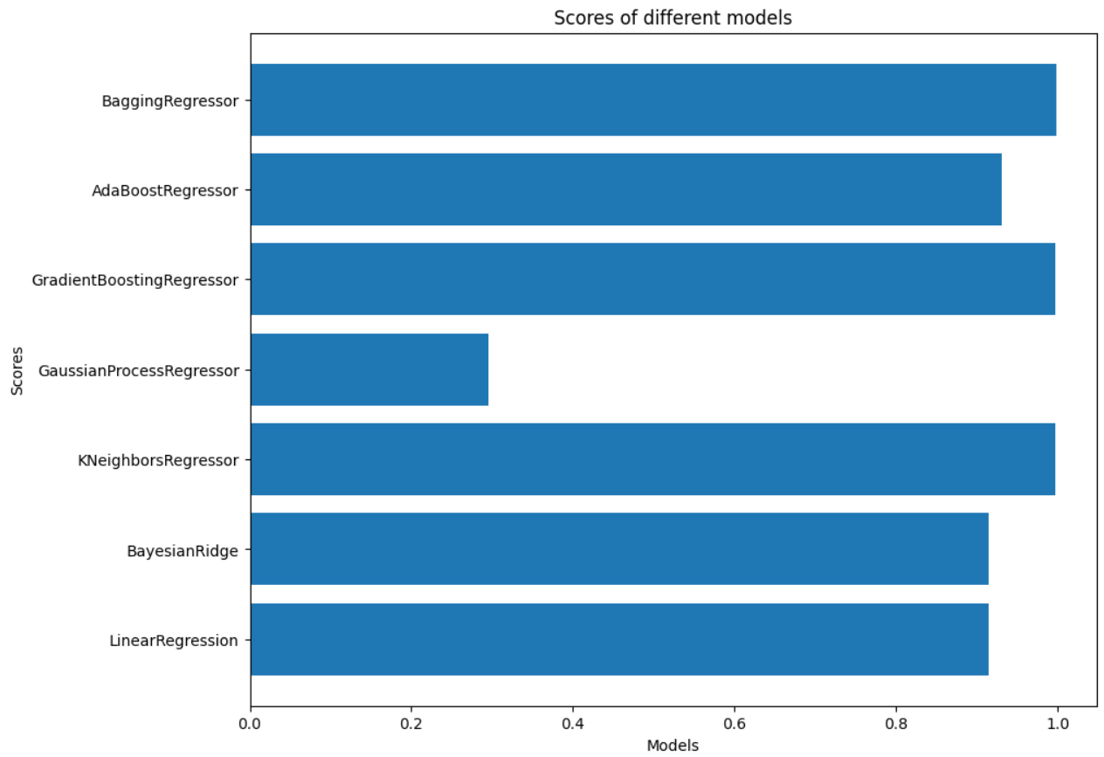
PLOTTING THE SCORES

Slide 11
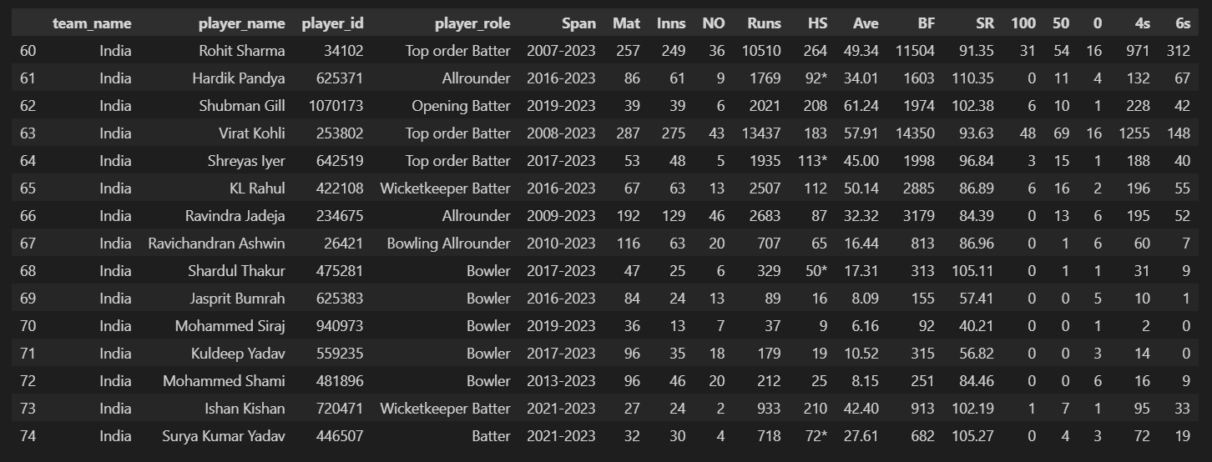
GENERALIZING
INDIAN TEAM

Slide 12


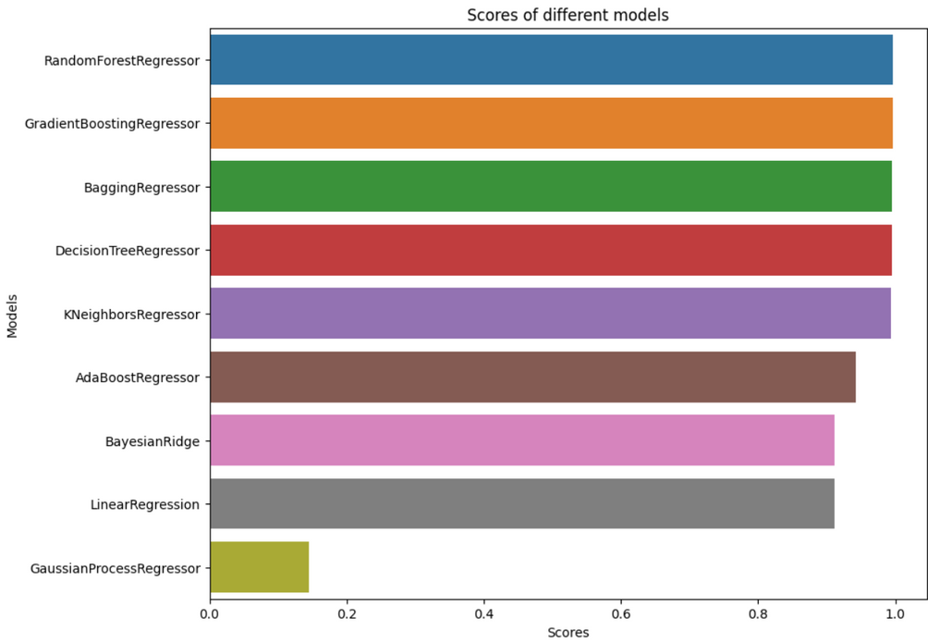
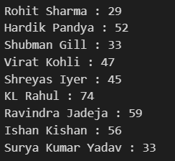
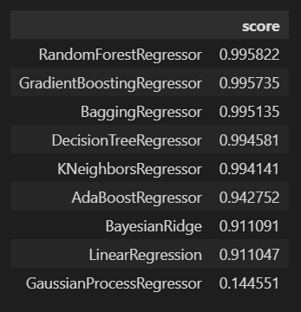
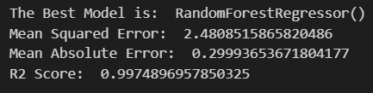
CONCLUSION
The Ensemble methods performed the best with `99.7%` accuracy, whereas the Gaussian Process Regression the worst with `14%` accuracy clearly indicating it's not an apt choice!

Slide 13

PREDICTING ECONOMY

Slide 14
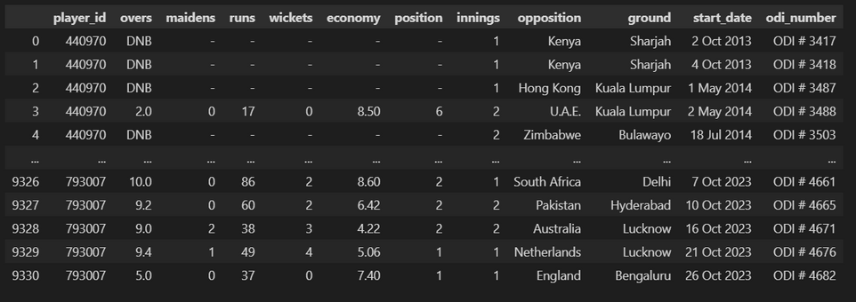

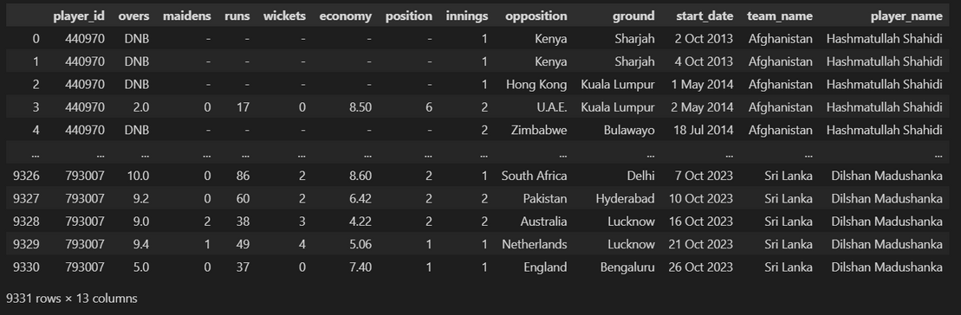
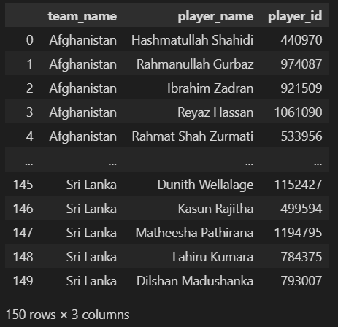
DATASET
PREPROCESSED DATA

Slide 15
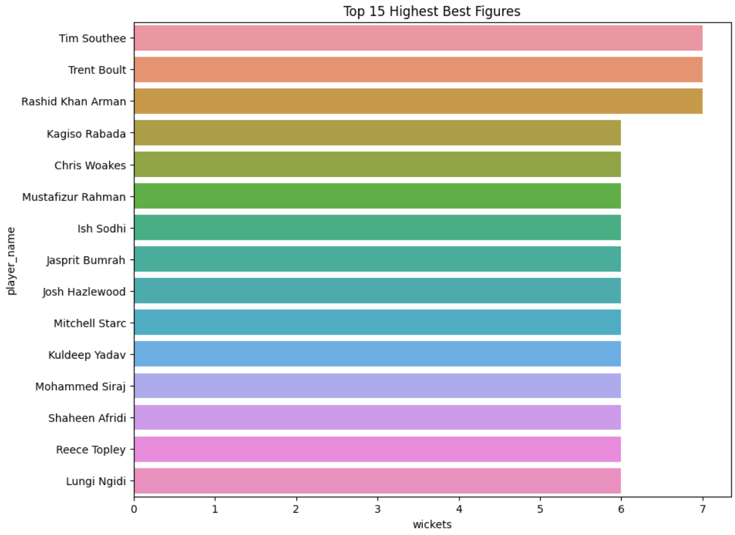

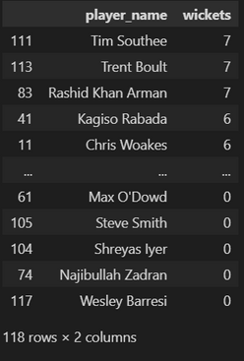

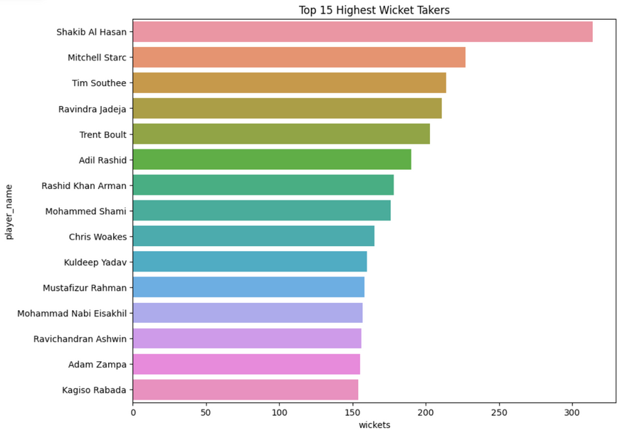
VISUALIZATION

Slide 16
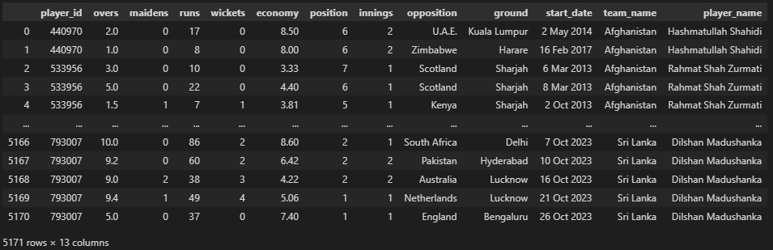
BOWLING DATA

Slide 17
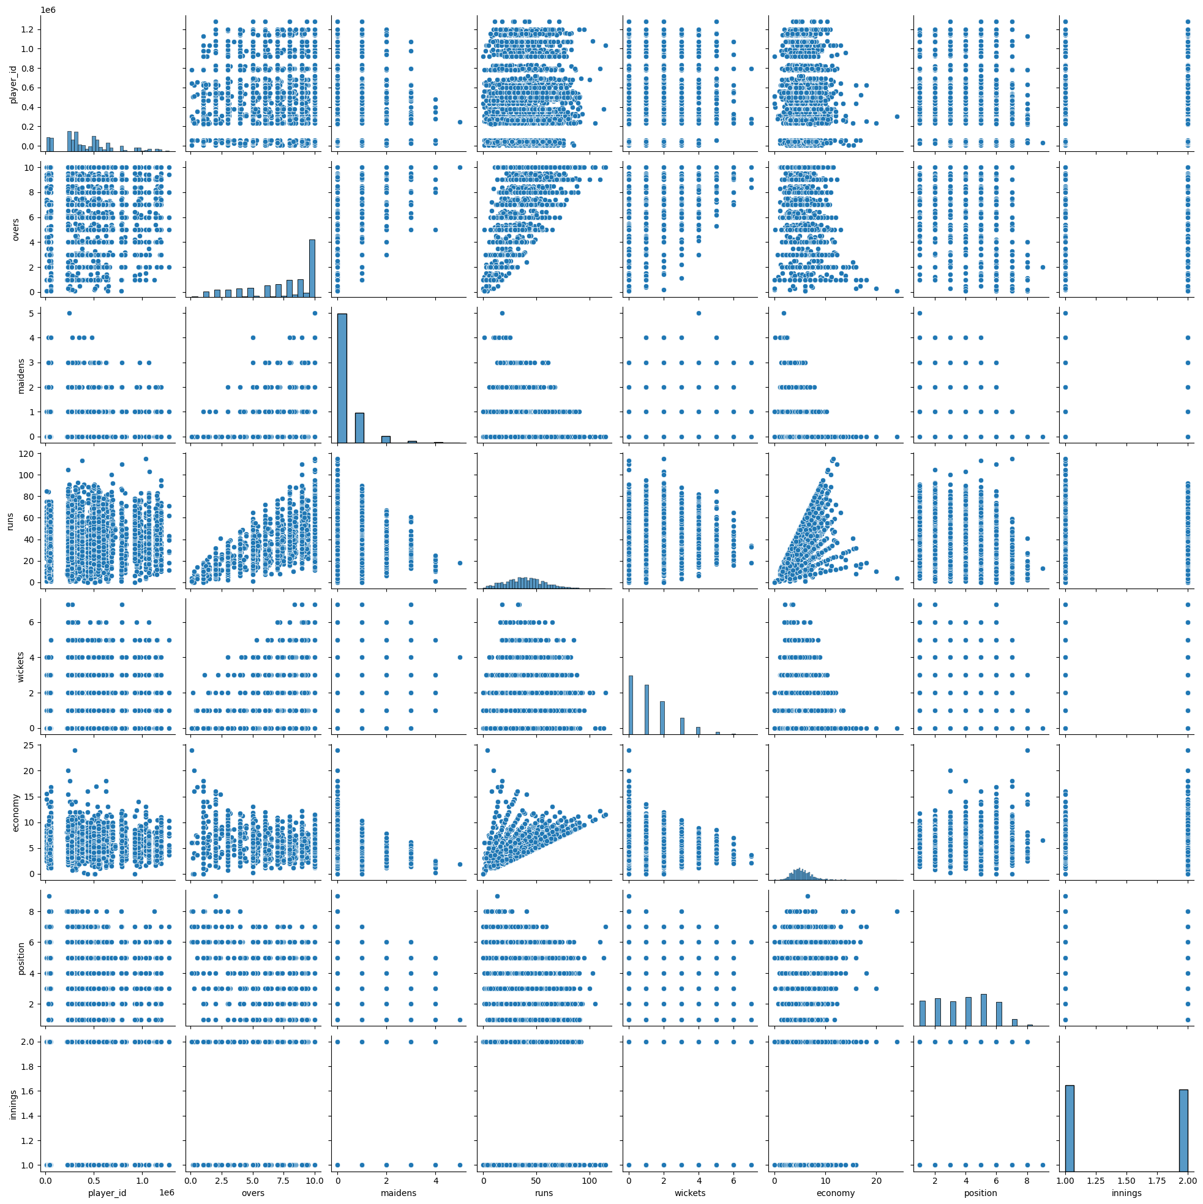

Slide 18

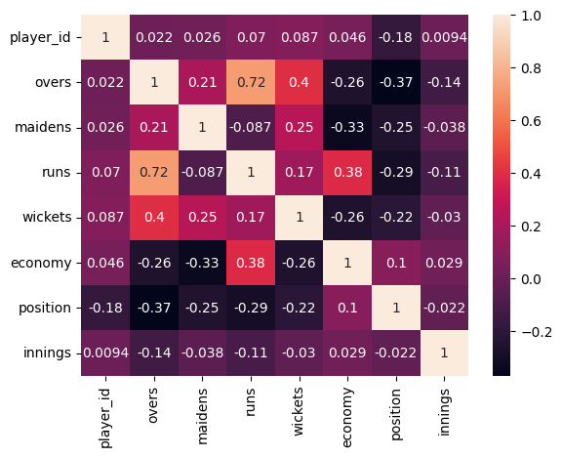
HEAT MAP

Slide 19
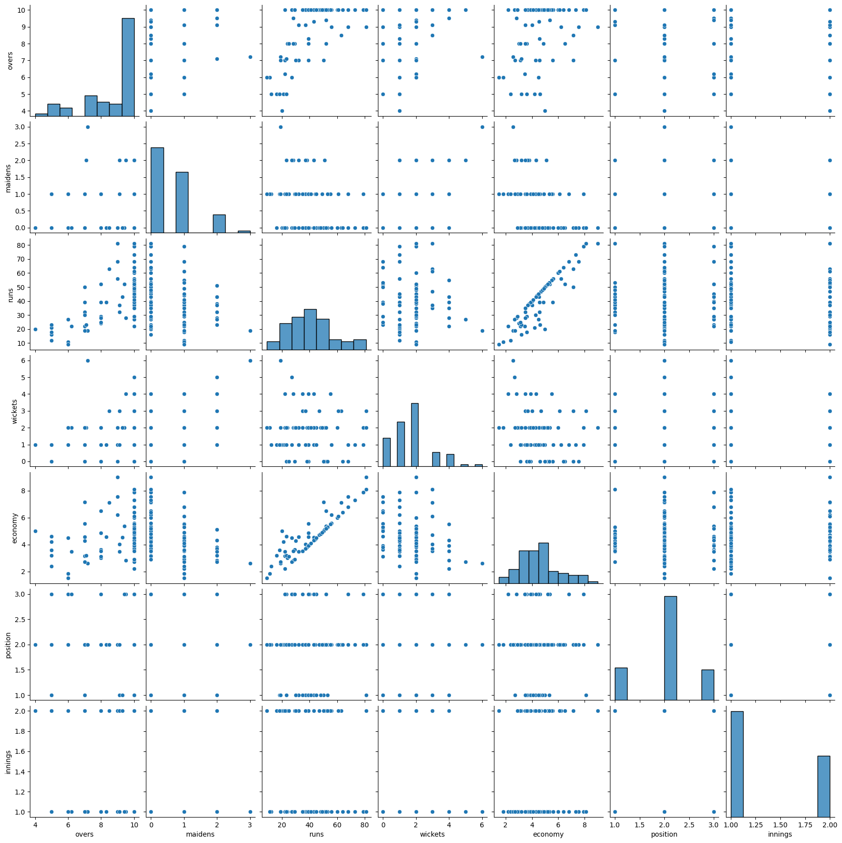

Slide 20

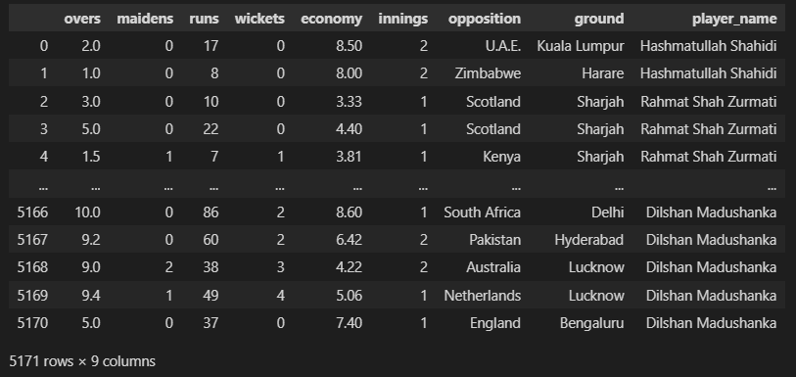
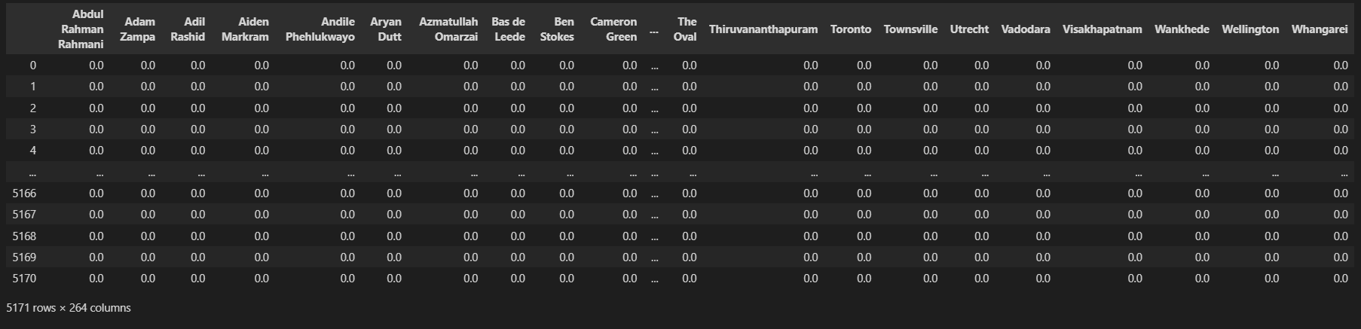

Slide 21
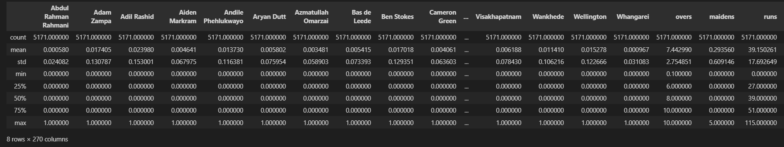
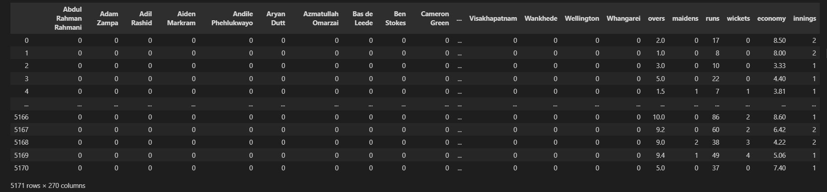

Slide 22
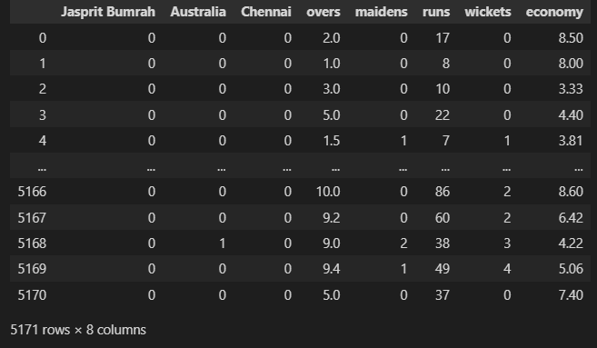
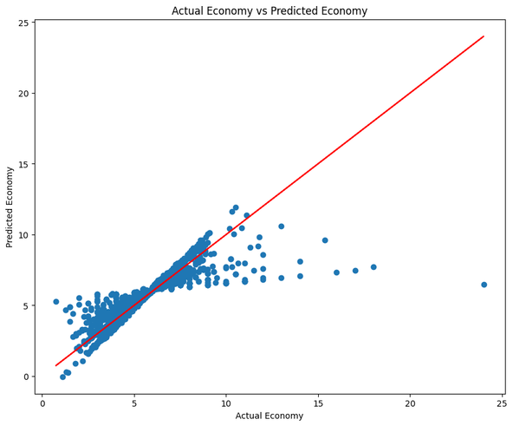

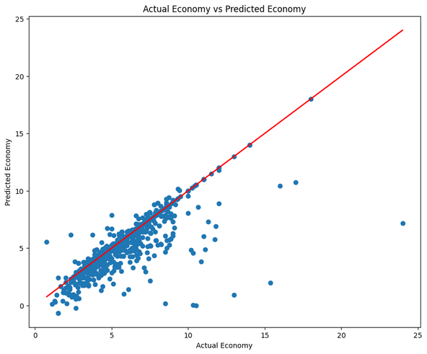
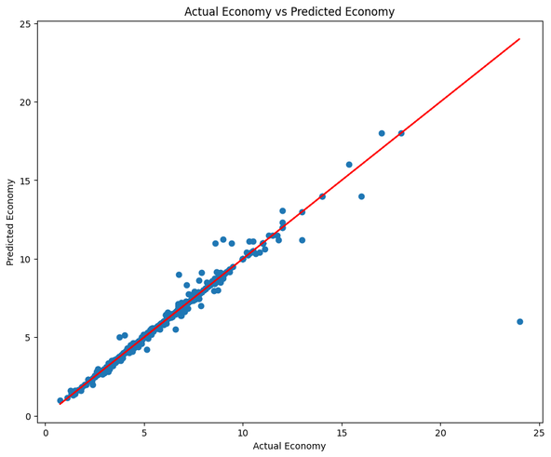
MODEL BUILDING
LINEAR REGRESSION
BAYESIAN REGRESSION
KNN REGRESSION
GAUSSIAN PROCESS REGRESSION
DECISION TREE REGRESSION

Slide 23

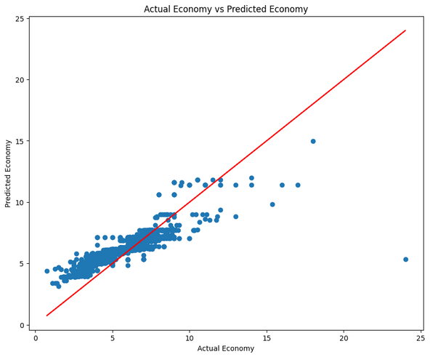


ENSEMBLE METHODS
GRADIENT BOOSTING REGRESSION
ADA BOOST REGRESSION
BAGGING REGRESSION
RANDOM FOREST REGRESSION

Slide 24

PLOTTING THE SCORES

Slide 25

GENERALIZING
INDIAN TEAM

Slide 26




CONCLUSION
The Ensemble methods performed the best giving an accuracy of `99.5%` Max. The `AdaBoost Regression` performed the worst with `38%` accuracy. From this we can conclude that the `Ensemble Methods` are the best for predicting the economy taken by a bowler in a match.

Slide 27

THANK YOU

